Slide 1
3D Reference

Slide 2
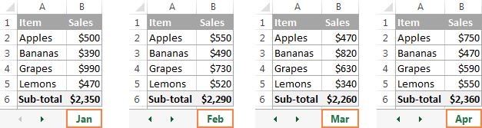
What is a 3D Reference?
An Excel 3D reference lets you refer to the same cell or a range of cells in several worksheets. Think of an example:
Suppose you want to find the grand total of earnings of Jan to Apr. How can you that?
Ans: Using 3D Reference “SUM(Jan:Apr!B6) or SUM(Jan:Apr!B1:B5)”

Slide 3
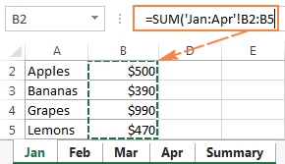
Create 3D Reference
Click the cell where you want to enter your 3D formula.
Type the equal sign (=), enter the function's name, and type an opening parenthesis, e.g. =SUM(
Click the tab of the first worksheet that you want to include in a 3D reference.
While holding the Shift key, click the tab of the last worksheet to be included in your 3D reference.
Select the cell or range of cells that you want to calculate.
Type the rest of the formula as usual.
Press the Enter key to complete your Excel 3-D formula.

Slide 4
Create a name for 3D Reference
On the Formulas tab, go to the Defined Names group and click Define Name.
In the New Name dialog, type some meaningful and easy-to remember name in the Name box, up to 255 characters in length.
Delete the contents of the Refers to box, and then enter a 3D reference there.
Click OK.
to sum the numbers in column B in all the worksheets from Jan through Apr, you just use this simple formula: =SUM(my_reference).
How can you create a 3D reference in defined name group?
Type = (equal sign).
Hold down Shift, click the tab of the first sheet you want to reference, and then click the last sheet.
Select the cell or range of cells to be referenced. You can also reference an entire column by clicking the column letter on the sheet.

Slide 5
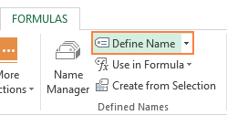
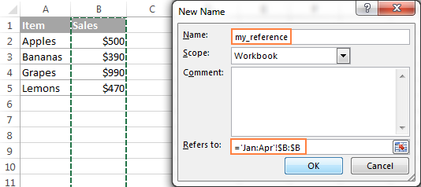
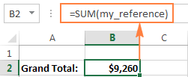
Create a name for 3D Reference

Slide 6
Some Excel functions supporting 3D Reference
SUM - adds up numerical values.
AVERAGE - calculates arithmetic mean of numbers.
AVERAGEA - calculates arithmetic mean of values, including numbers, text and logicals.
COUNT - Counts cells with numbers.
COUNTA - Counts non-empty cells.
MAX - Returns the largest value.
MAXA - Returns the largest value, including text and logicals.
MIN - Finds the smallest value.
MINA - Finds the smallest value, including text and logicals.
PRODUCT - Multiplies numbers.
STDEV, STDEVA, STDEVP, STDEVPA - Calculate a sample deviation of a specified set of values.
VAR, VARA, VARP, VARPA - Returns a sample variance of a specified set of values.

Slide 7
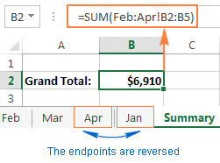
How 3D References change?
If you:
Insert, move or copy sheets within endpoints.
Delete or move sheets outside of endpoints.
Move an endpoint.
Reverse endpoint.
Delete an endpoint.

Slide 8
Structured Reference

Slide 9
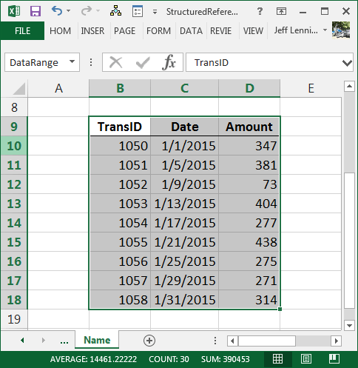
Named Ranges
First we need to convert data into table. To convert:
Go to Insert tab.
Select Table Command.
Now, assign a name to the table:
Go to Formulas tab.
Select Name Manager from Define Names group.
Select Edit.
Type a suitable name for your table in Name box.
Press Ok.

Slide 10
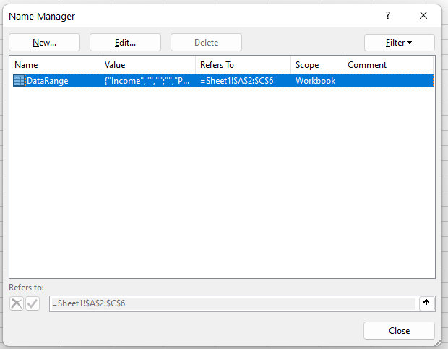
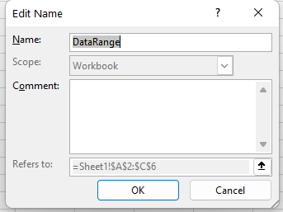
Named Ranges (Cntd…)
Task-1: Convert one of your worksheets into a table & save it as myTable.

Slide 11
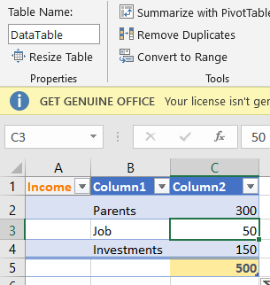
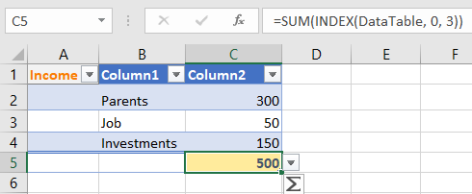
Create Structured Reference
=INDEX(Reference, row_num, [column_num])
Where:
reference is the entire reference, such as our DataTable
row_num is the row number, or 0 for all rows
[column_num] is the optional column number, or 0 for all columns
Note: Row & Column Number needs to be written according to table not worksheet.

Slide 12
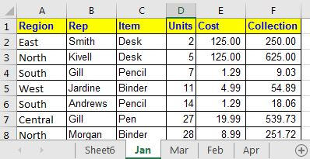
Tasks
Input these data into your worksheet & find total cost and total collection using structured reference.

Slide 13
Tasks
Input these data into your worksheet & find total cost and total collection using structured reference.

Slide 14
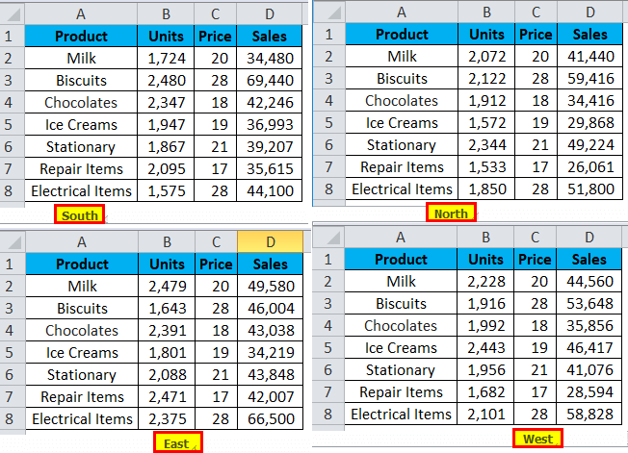
Tasks
Create these 4 worksheets using Excel & Find the total amount of sales in every region using structured Reference & find the Grand total sales in 4 regions using 3D reference.

Slide 15
THANKS

